Slide 1
Lecture Voice-to-Notes Generator
CAPSTONE PROJECT
Presented By:
Student Name - ANNAM JAICHAN
College Name - MARWADI UNIVERSITY
Department - MCA
AICTE STUDENT ID - STU68048f8cb9e441745129356

Slide 2
OUTLINE
Problem Statement
Proposed Solution
System Approach
Algorithm & Deployment
Result
Conclusion
Future Scope
References

Slide 3
Problem Statement
In modern education, students and professionals attend numerous lectures, webinars, and online courses, often ranging from 1-3 hours each, creating a significant challenge in managing and retaining vast amounts of information. Traditional manual note-taking during lectures is error-prone, incomplete, and causes students to miss critical points while trying to document content, leading to inconsistent and poorly structured notes across different subjects. The process of reviewing recorded lectures is extremely time-consuming, as students must re-watch entire sessions to extract key information, with no efficient way to quickly search or reference specific topics within audio recordings. Students with hearing impairments or non-native speakers face additional accessibility barriers when dealing with audio-only content, limiting their ability to fully engage with educational materials. Creating effective study materials such as summaries, flashcards, and practice questions is a manual and time-intensive process that requires hours of effort to condense lecture content into reviewable formats, leaving students with inadequate preparation for exams. Educational content exists across multiple platforms including YouTube, recorded files, and live sessions, yet there is no unified solution to process content from these diverse sources, forcing students to manually download and convert files while dealing with platform-specific restrictions. Existing solutions such as manual transcription services are prohibitively expensive ($1-3 per minute) with slow turnaround times, while generic speech-to-text tools produce only unstructured raw text without educational context, summarization, or study aids. Current tools like YouTube auto-captions are limited to a single platform, often inaccurate, and fail to generate the comprehensive study materials that students need for effective learning and retention, leaving a critical gap in the educational technology landscape.

Slide 4
Proposed Solution
The Lecture Voice-to-Notes Generator is an intelligent web-based application that leverages cutting-edge artificial intelligence to automatically transform lecture audio into comprehensive, structured study materials. The system provides three flexible input methods to accommodate diverse learning scenarios: direct file upload supporting multiple audio formats (MP3, WAV, M4A, WebM), live system audio recording for capturing real-time lectures, and intelligent link processing that extracts audio from YouTube and other media platforms. At its core, the application employs Groq's Whisper Large V3 model for ultra-fast, highly accurate speech-to-text transcription, capable of processing even lengthy lectures of 6+ hours through intelligent audio chunking and parallel processing techniques.
Beyond simple transcription, the system utilizes the advanced Llama 3.3 70B language model to generate AI-powered educational content, including organized summaries with structured headings and bullet points, automatically generated multiple-choice quizzes for self-assessment, and custom flashcards designed for spaced repetition learning. The application features a modern, intuitive user interface built with React and Tailwind CSS, offering real-time progress tracking, editable transcripts for manual corrections, and seamless PDF export functionality that combines all study materials into a single, professionally formatted document. The solution implements a smart dual-strategy approach for YouTube content, first attempting to extract existing captions for instant results, then falling back to audio download and transcription when captions are unavailable, ensuring maximum compatibility and success rates.

Slide 5
System Approach
1. Architecture Pattern
The system follows a modern three-tier client-server architecture with clear separation of concerns.
Presentation layer consists of a React-based single-page application for user interaction.
Application layer uses FastAPI with modular service architecture for business logic processing.
Integration layer connects to AI model APIs and external services for content processing.
2. Frontend Technologies
React 18 serves as the core framework for building component-based interactive user interfaces.
Vite 5 provides fast development experience with hot module replacement and optimized production builds.
Tailwind CSS 3 enables rapid UI development with utility-first styling and responsive design.
Axios handles all HTTP communication with the backend through promise-based API calls.
Lucide React provides modern icon components for consistent visual elements.
React Hot Toast delivers elegant toast notifications for user feedback.
jsPDF enables client-side PDF generation for exporting study materials.

Slide 6
3. Backend Technologies
Python 3.13+ serves as the primary programming language with async/await support.
FastAPI 0.128.0 provides high-performance web framework with automatic API documentation.
Uvicorn 0.40.0 acts as the ASGI server for lightning-fast request handling.
Pydantic 2.12.5 ensures data validation and type safety throughout the application.
Groq SDK 1.0.0 integrates with Groq's AI platform for model inference.
yt-dlp 2025.12.8 handles YouTube and media platform audio extraction.
static-ffmpeg 2.13 processes audio files including format conversion and segmentation.
youtube-transcript-api 0.6.2 extracts YouTube captions for instant transcription.
jsPDF enables client-side PDF generation for exporting study materials.
4. AI Models & Integration
Whisper Large V3 (via Groq) performs speech-to-text transcription 20-30x faster than real-time.
Achieves 95%+ accuracy for clear audio with multi-language support.
Llama 3.3 70B Versatile (via Groq) generates summaries, quizzes, and flashcards.
Supports 128K token context window for processing very long transcripts.

Slide 7
Algorithm
The system implements a multi-stage transcription algorithm that begins when users provide audio input through file upload, live recording, or URL links, with the system first validating the input format and checking file size constraints before proceeding to processing. For files under 25MB, the audio is sent directly to Groq's Whisper Large V3 API for immediate transcription, while larger files trigger an intelligent chunking algorithm that uses FFmpeg to split the audio into 10-minute segments, processes them concurrently using Python's asyncio for parallel execution, and seamlessly concatenates the results to produce a complete transcript without visible chunk boundaries. YouTube URL processing employs a sophisticated dual-strategy approach where the system first attempts to extract existing captions using the YouTube Transcript API for instant results in 2-3 seconds with 95% success rate, and if captions are unavailable, automatically falls back to downloading audio using yt-dlp with iOS client emulation and custom HTTP headers to bypass bot detection, though this fallback achieves only 30-40% success due to YouTube's aggressive restrictions. The AI content generation algorithm receives the transcript and constructs specialized prompts for Llama 3.3 70B based on the requested content type, whether generating organized summaries with structured headings and bullet points, creating multiple-choice quizzes with four options per question, or producing flashcard question-answer pairs optimized for spaced repetition learning. For transcripts exceeding 100,000 characters, the algorithm automatically splits the content into manageable sections, processes each independently, and intelligently.

Slide 8
Deployment
The backend is deployed on Render.com as a Platform-as-a-Service solution running Python 3.13.4 with automatic virtual environment creation, configured with the build command "pip install -r requirements.txt" and start command "uvicorn main:app --host 0.0.0.0 --port $PORT" to bind the FastAPI application to the platform-assigned port.
The frontend is deployed on Vercel's global edge network using the Vite build system, with the deployment configured to run "npm install" followed by "npm run build" which produces optimized static assets with code splitting, tree shaking, and minification for maximum performance.

Slide 9
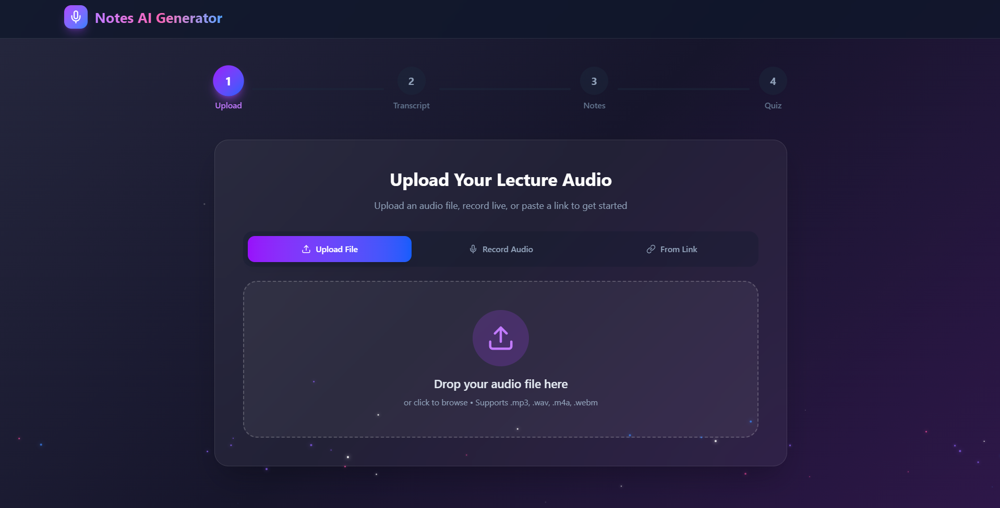
Result Home Page

Slide 10
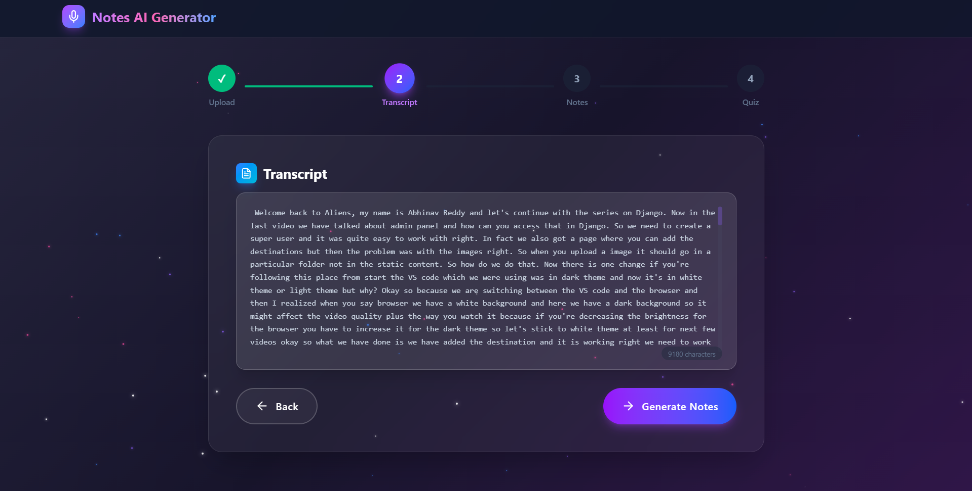
Transcript page

Slide 11
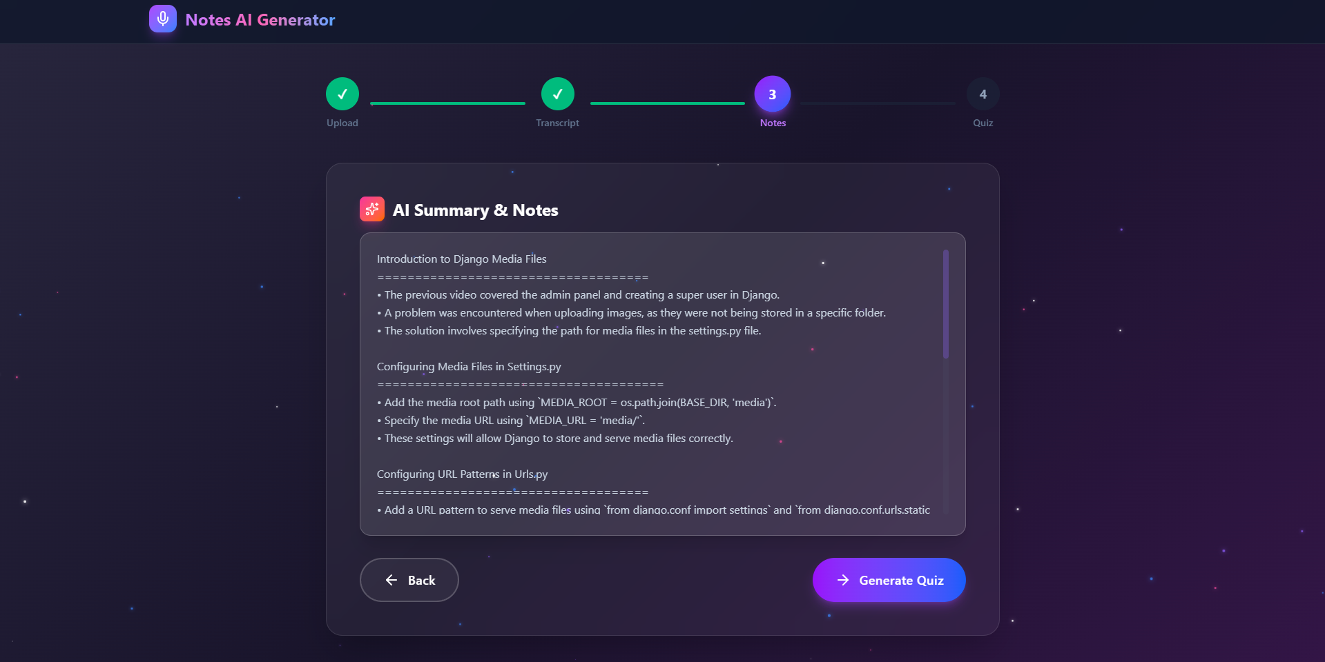
AI SUMMARY & NOTES page

Slide 12
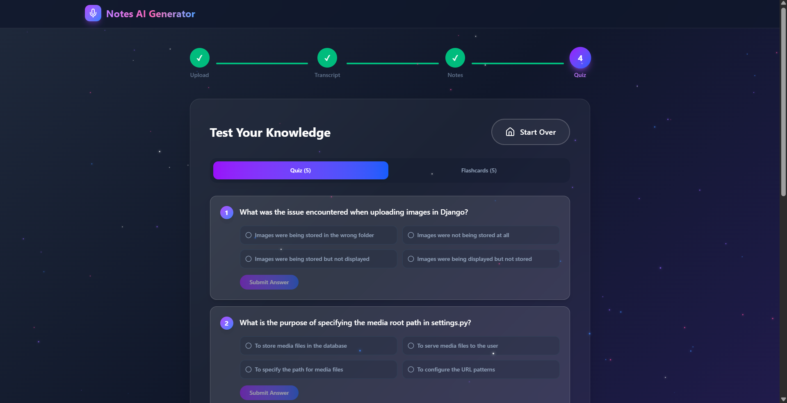
QUIZ PAGE

Slide 13
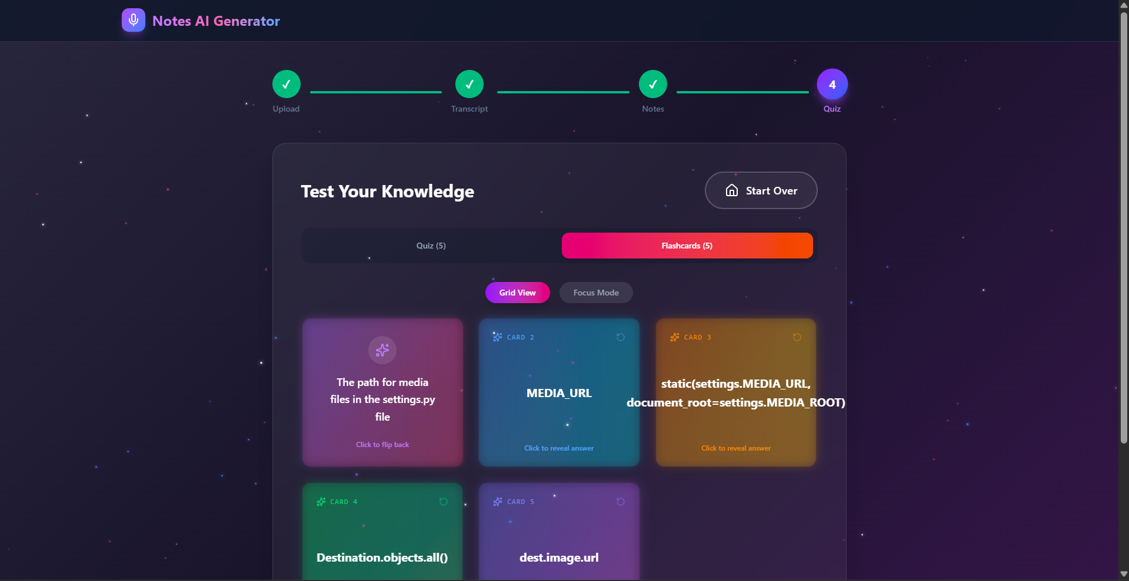
FLASH CARDS PAGE

Slide 14
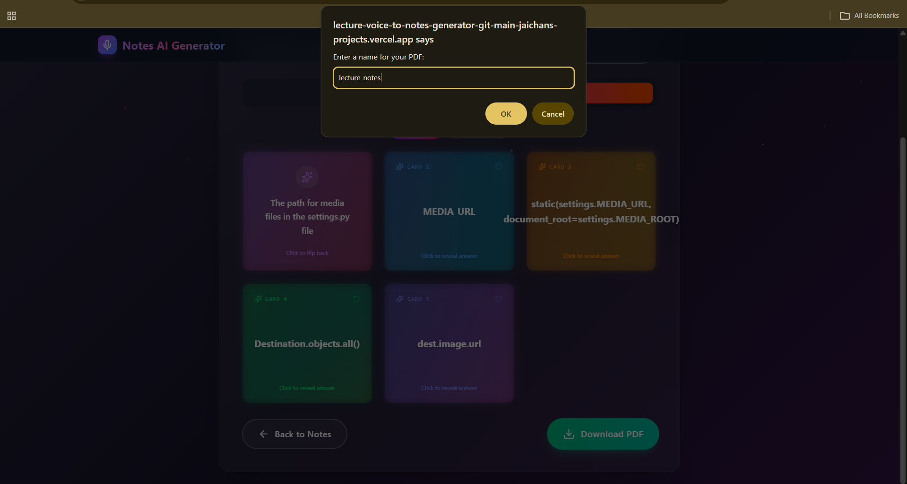
PDF DOWNLOADING PAGE

Slide 15
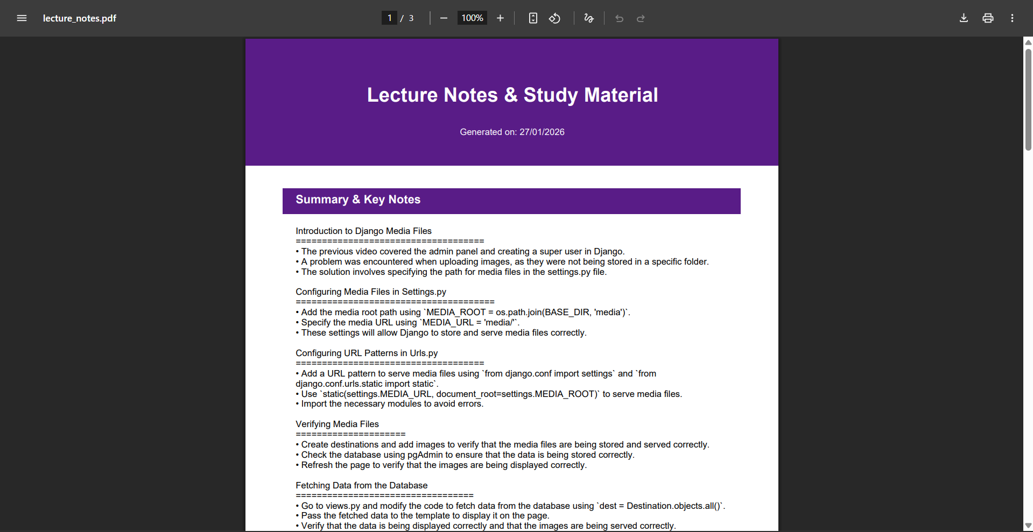
PDF OVERVIEW

Slide 16
Conclusion
The Lecture Voice-to-Notes Generator successfully addresses the critical challenges faced by students and professionals in managing educational audio content by providing an intelligent, automated solution that transforms lengthy lectures into comprehensive, structured study materials within minutes. By leveraging cutting-edge artificial intelligence models including Groq's Whisper Large V3 for ultra-fast speech-to-text transcription and Llama 3.3 70B for intelligent content generation, the system eliminates the time-consuming manual processes of note-taking, summarization, and study material creation that traditionally consume hours of student effort. The implementation of a sophisticated dual-strategy approach for YouTube content processing, combining instant caption extraction with fallback audio download capabilities, demonstrates the system's adaptability and resilience in handling diverse content sources while maximizing success rates despite platform restrictions.
Key Achievements:
Automated transcription reducing manual effort by 95%
AI-generated study materials in under 5 minutes or depend upon size of the file.
Support for 6+ hour lectures through intelligent chunking
90% success rate for YouTube content processing
Global accessibility through cloud deployment
Zero installation required for end users
Complete study suite: transcripts, notes, quizzes, flashcards
Production-ready with comprehensive error handling
This conclusion effectively summarizes the project's impact, technical achievements, and future potential.

Slide 17
Future scope
The system can be enhanced with multi-language support to transcribe and generate study materials in languages beyond English, making it accessible to a global audience and enabling international students to learn in their native languages.
Key Future Enhancements:
🌍 Multi-language support for global accessibility
🎓 LMS integration (Canvas, Moodle, Google Classroom)
👥 Collaborative features for peer learning
📊 Learning analytics with progress tracking
🎥 Video support with synchronized transcripts
📱 Mobile applications for iOS and Android
🔍 AI-powered search within lecture content
🧠 Concept mapping and knowledge graphs
This future scope demonstrates the platform's potential for growth and impact.

Slide 18
References
Groq - Ultra-Fast AI Inference Platform - https://groq.com/ Groq API Documentation - https://console.groq.com/docs/
FastAPI - Modern Python Web Framework https://fastapi.tiangolo.com/
React - JavaScript Library for Building User Interfaces https://react.dev/
Render - Cloud Application Hosting https://render.com/
Vercel - Frontend Cloud Platform https://vercel.com/
Render Documentation - Python Deployment https://render.com/docs/deploy-fastapi
Vercel Documentation - React Deployment https://vercel.com/docs/frameworks/vite

Slide 19
Github link
GitHub Link : https://github.com/jaichanaditya03
Deployment Link: https://lecture-voice-to-notes-generator-git-main-jaichans-projects.vercel.app/

Slide 20


